Slide 1
3Slides
Presented by: Ilkin Namazli
Boston Consulting Group
Market Analysis:
Key insights from consumer survey defines our target market

Slide 2
Executive summary model answer:
Company X's declining market share and ARPU, spurred by uninspiring offerings, warrant investigating alternative options to reignite profitability. Handset leasing presents a promising avenue, with potential revenue growth estimates ranging from 2.3% to 4.25% based on comparable market responses. Our research identifies "Young People" as the ideal target segment, prompting the proposed product name "Save & Upgrade." We recommend implementing this program to address stagnant consumer interest and drive sustainable financial growth.
Page

Slide 3
Oppurtunities
1
2
3
Segment Analysis
Marketing Oppurtunity 1
Marketing Oppurtunity 2
Younger people prefer leasing for frequent upgrades: 63% of people under 30 are interested in leasing to upgrade every 12 months.
Offer affordable upgrade programs or flexible payment plans to reduce upfront costs.
Offer competitive discounts on phone plans and bundle options to attract price-sensitive customers.
4
5
Marketing Oppurtunity 3
Marketing Oppurtunity 4
Increase awareness and accessibility of phone insurance, especially for those prone to accidental damage.
Highlight trade-in value and consider bundled insurance to address cost concerns.
Page

Slide 4
Key Insights:
Younger people prefer leasing for frequent upgrades: 63% of people under 30 are interested in leasing to upgrade every 12 months, compared to only 28% of those over 30.
Desire for more frequent upgrades: 48% currently upgrade every 24 months, but 71% of those would upgrade more often if it weren't more expensive.
Upfront cost is a major barrier: 60% say upfront cost is the most important factor when buying a phone, and 46% wouldn't pay more than $500 upfront.
Trading in common, insurance rare: 58% trade in their phones, while 92% never buy insurance.
Telco providers could attract customers with discounts: 18% would switch providers for a 10% discount, and 45% for a 10-20% discount.
High rate of accidental damage: 38% have replaced phones before their contract due to damage.
Page

Slide 5
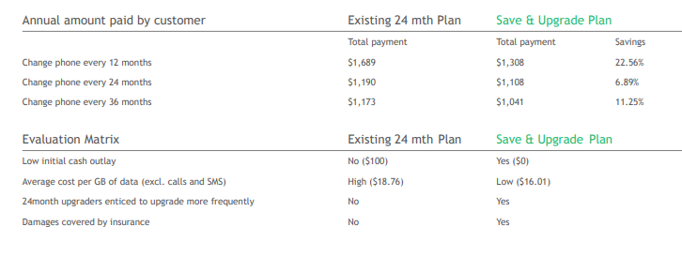
Market ‘SIM-Only + Leasing’ plan as “Save & Upgrade” plan
No proposed changes required to the current SIM-Only + Leasing plan
Page

